Slide 1
Correlation & Simple linear Regression
Exploring relationships among variables

Slide 2
Correlation is used to describe the strength and direction of the relationship between two variables (usually continuous – but can be used when one of the variables is dichotomous i.e. has only two values)
The most common statistic obtained is Pearson’s product-moment correlation (r)
Partial correlation is used when you wish to explore the relationship between two variables while statistically controlling for a third variable

Slide 3
Uses of Correlation Techniques
Correlation techniques are used to:
Explore the association between pairs of variables (correlation)
Predict scores on one variable from scores on another variable (bivariate regression)
Predict scores on a dependent variable from scores on a number of independent variables (multiple regression)

Slide 4
Correlation vs. Causality
Correlation provides an indication of a relationship between variables
It does not indicate that one variable causes the other
Strong correlation between variables A & B
A causes B?
B causes A?
C causes both A & B ?
Ice cream sales and homicides in New York
Smoking and lung cancer

Slide 5
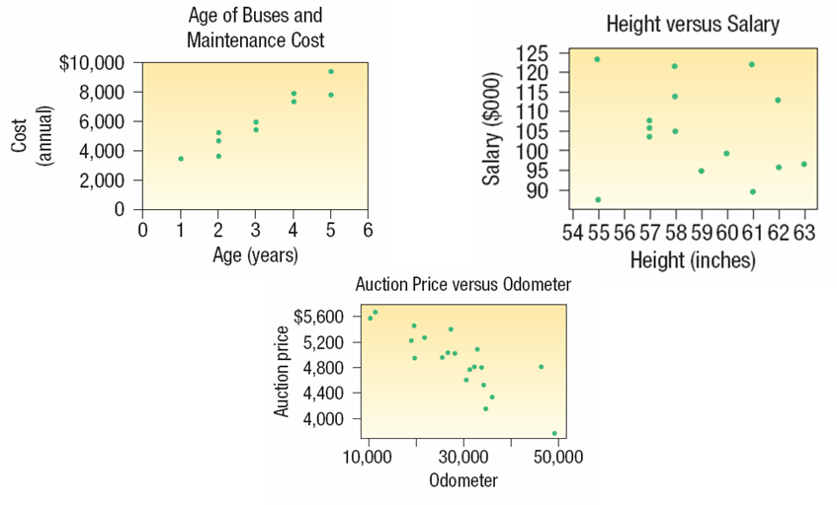
When we study the relationship between two variables we refer to the data as bivariate.
The relationship between variables can be inspected visually by generating a scatter plot/diagram

Slide 6
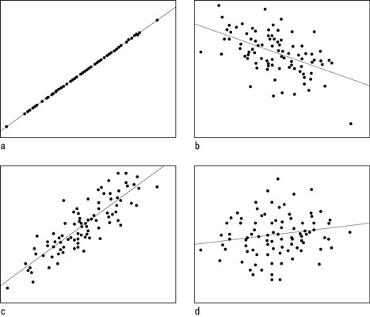
Interpreting a scatterplot
A scatterplot will provide information on both the direction of the relationship (positive or negative) and the strength of the relationship
Perfect correlation – a straight line
No correlation (r = 0) – blob of points/no pattern
Scatterplots with correlations of a) +1.00; b) –0.50; c) +0.85; and d) +0.15.

Slide 7
Factors to consider
The correlation coefficient (r) provides an indication of the linear (straight line) relationship between variables.
Pearson’s r will underestimate the the strength of relationship when the variables are related in non-linear form
Be careful of a restricted range of scores – there should be as wide a range of scores on each of the two variables as possible.

Slide 8
Factors to consider
Outliers can have a dramatic effect on the correlation coefficient (especially with small samples) – check scatterplot
Statisticians often check data for outliers and remove them manually.
In the case of linear regression, outliers can be identified visually, although it is never completely clear whether an outlier is an error or just a surprising, but correct, value.
Outliers dramatically affect the usual least-squares regression because the squared distance measure accentuates the influence of points far away from the regression line.

Slide 9
Statistical vs practical significance
With large samples, even quite small correlation coefficients can reach statistical significance
- but practical significance may be very limited

Slide 10
Assumptions common to all Correlation Techniques
The scale of measurement for the variables should be interval or ratio (continuous)
Exception: One dichotomous independent variable with two values and one continuous variable
Spearman’s rho (a non-parametric alternative) is a correlation coefficient suitable for ordinal or ranked data
Related pairs: each subject must provide a score on both variable X and variable Y

Slide 11
Assumptions common to all Correlation Techniques
Independence of Observations: Each observation or measurement must not be influenced by any other observation or measurement
Any situation where measurements are collected in a group setting, or participants interact, may be suspect

Slide 12
Assumptions common to all Correlation Techniques
Normal Distribution: inspect histograms
Linearity: Relationship between two variables should be linear
Homoscedacticity: Consistency of Variance

Slide 13
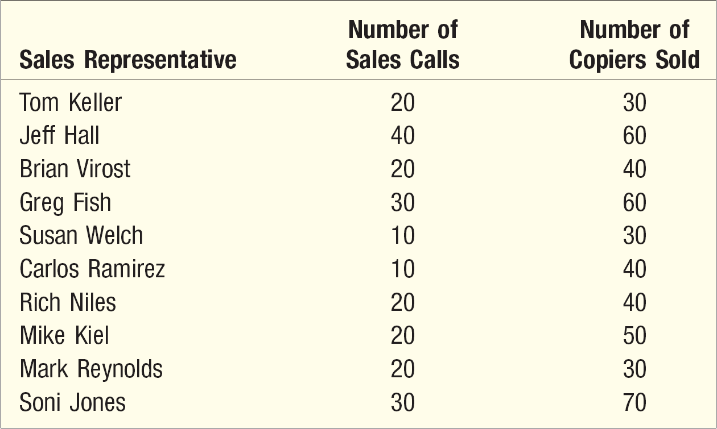
Scatter Diagram Example
The sales manager of Copier Sales of America, wants to determine whether there is a relationship between the number of sales calls made in a month and the number of copiers sold that month. The manager selects a random sample of 10 representatives and determines the number of sales calls each representative made last month and the number of copiers sold.

Slide 14
The Coefficient of Correlation, r
The coefficient of correlation (r) is a measure of the strength of the relationship between two variables.
Shows the direction and strength of the linear relationship between two interval or ratio-scale variables.
Ranges from –1.00 to +1.00.
Values of –1.00 or +1.00 indicate perfect and strong correlation.
Values close to 0.0 indicate weak correlation.
Negative values indicate an inverse relationship, and positive values indicate a direct relationship.

Slide 15
The value of r ranges between ( -1) and ( +1)
The value of r denotes the strength of the association as illustrated by the following diagram.
What represents a strong correlation really depends on the field in which you are using the correlation. Social sciences may accept lower correlations as being intermediate and strong as very high correlations are extremely rare in that field.
strong
intermediate
weak
weak
intermediate
strong
-1
-0.75
-0.25
0
0.25
0.75
1
Indirect
Direct
perfect correlation
perfect correlation
no relation

Slide 16
Correlation Coefficient – Example
Using the Copier Sales of America data, which is shown here in a scatter plot, compute the correlation coefficient and coefficient of determination.
Using the formula:

Slide 17
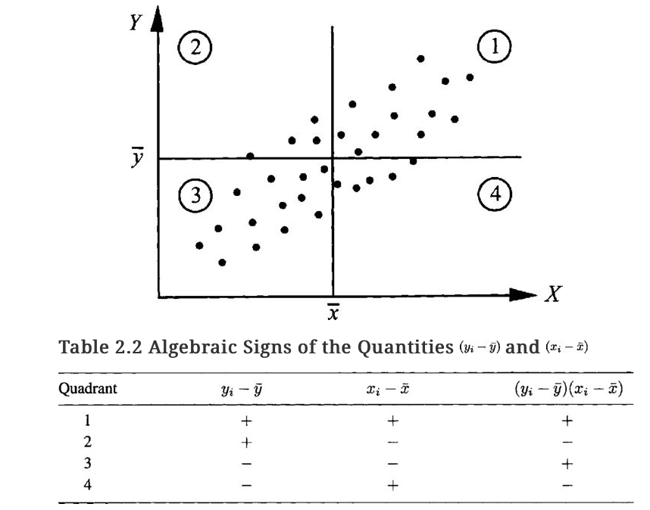

Slide 18
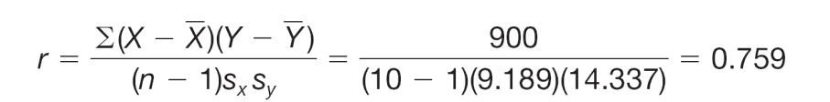
Correlation Coefficient – Example
What does correlation of 0.759 mean?
It is positive–a direct relationship between the number of sales calls and the number of copiers sold.
0.759 is fairly close to 1.00 – the association is strong.

Slide 19
Using SPSS Two types of correlation analysis
Simple bivariate correlation (zero order correlation)
Partial correlation (controlling for another variable)
First Steps
Generate Scatterplot
Check for outliers
Inspect distribution of data points
Determine direction of relationship
Request Pearson’s r or Spearman rho
Check info about the sample
Determine strength of relationship
Calculate/interpret coefficient of determination
Assess the significance level

Slide 20
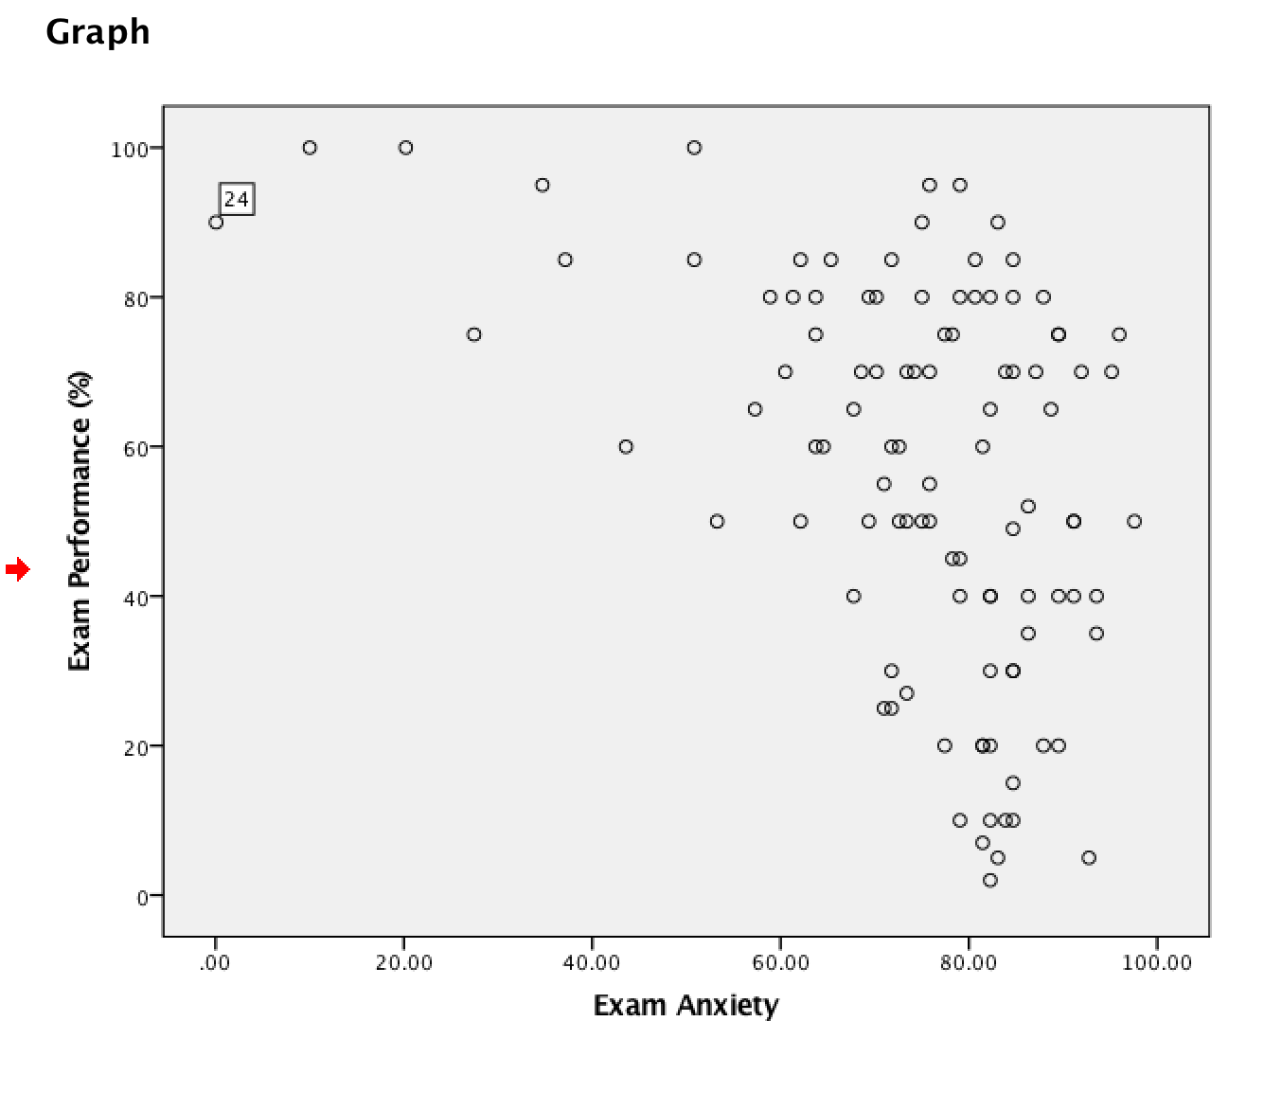
Exam Anxiety Example
Generate Scatterplot
Check for outliers
Inspect distribution of data points
Determine direction of relationship

Slide 21
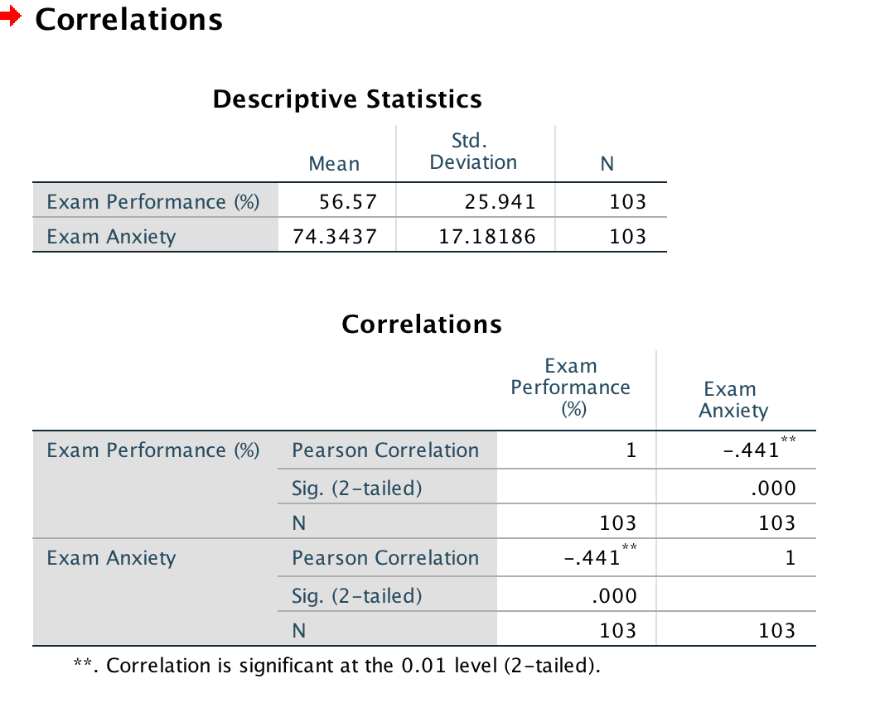
Exam Anxiety Example
Request Pearson’s r or Spearman rho
Check info about the sample
Determine strength of relationship
Calculate/interpret coefficient of determination
Assess the significance level

Slide 22
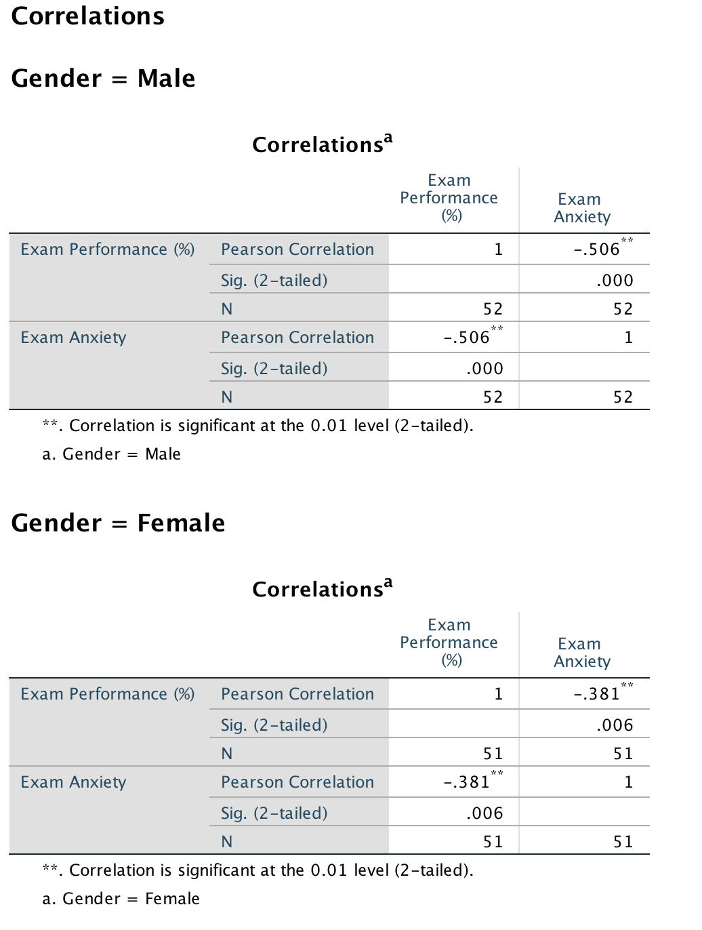
Exam Anxiety Example Split File by Gender

Slide 23
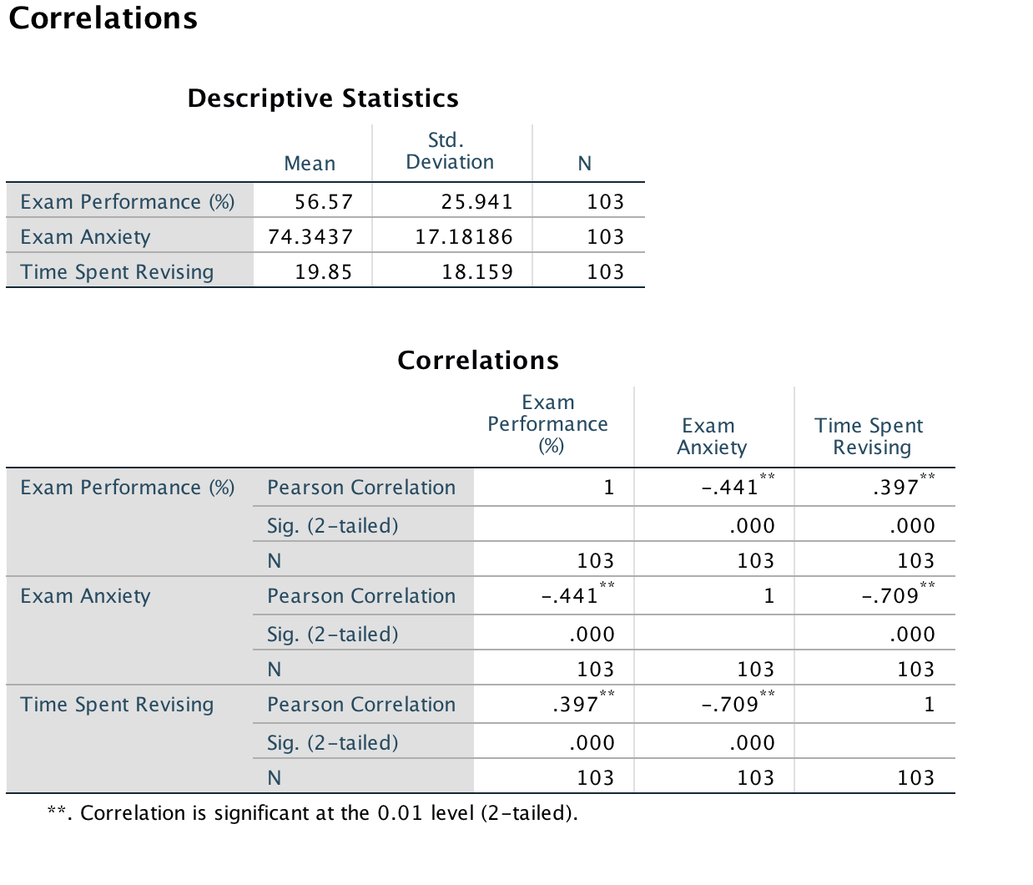
Exam Anxiety Example 3x3 Correlation Matrix

Slide 24
Partial Correlation
Measures the relationship between two variables, controlling for the effect that a third variable has on them both.
Allows you to control for an additional variable
Statistically remove the influence of a ‘confounding’ variable
Relationship between A and B is influenced to some extent by a third variable C
Notes:
B

Slide 25
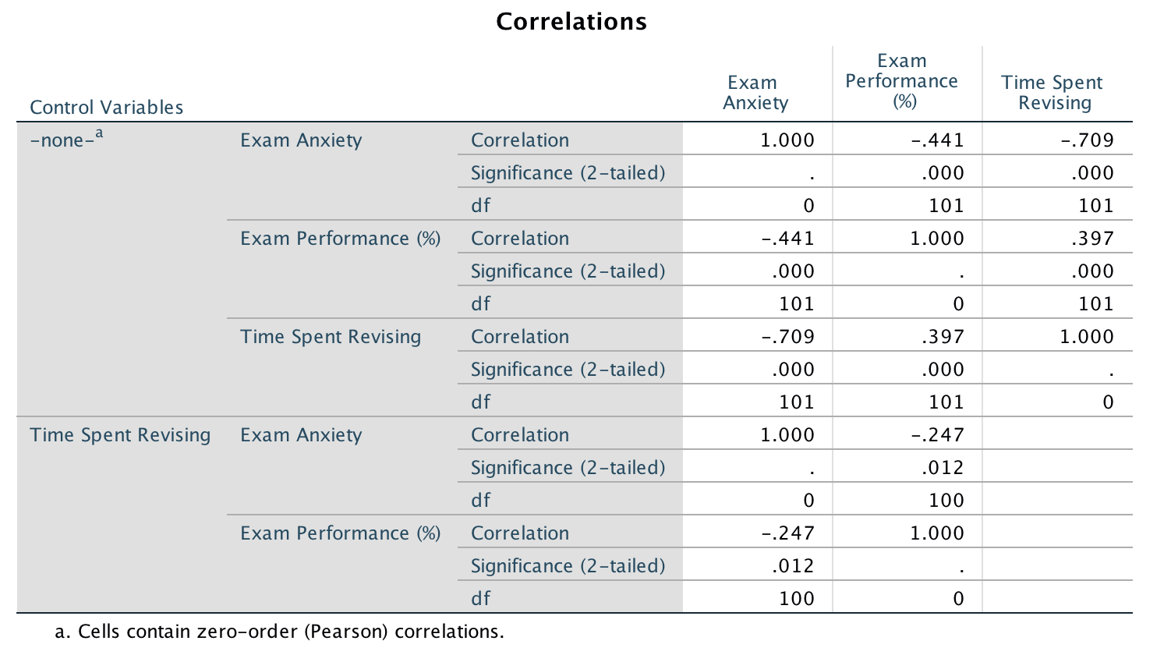
Partial Correlation
Zero-order correlation
Controlling for effects of the control variable
Notes:
B

Slide 26
Example of Presenting Results – Correlation
The relationship between perceived control of internal states (as measured by the PCOISS) and perceived stress (as measured by the Perceived Stress Scale) was investigated using Pearson product-moment correlation coefﬁcient.
Preliminary analyses were performed to ensure no violation of the assumptions of normality, linearity and homoscedasticity.
There was a strong, negative correlation between the two variables, r = –.58, n = 426, p < .001, with high levels of perceived control associated with lower levels of perceived stress.

Slide 27
Example of Presenting Results Partial Correlation
Partial correlation was used to explore the relationship between perceived control of internal states (as measured by the PCOISS) and perceived stress (measured by the Perceived Stress Scale), while controlling for scores on the Marlowe-Crowne Social Desirability Scale.
Preliminary analyses were performed to ensure no violation of the assumptions of normality, linearity and homoscedasticity.
There was a strong, negative, partial correlation between perceived control of internal states and perceived stress, controlling for social desirability, r = –.55, n = 425, p < .001, with high levels of perceived control being associated with lower levels of perceived stress. An inspection of the zero order correlation (r = –.58) suggested that controlling for socially desirable responding had very little effect on the strength of the relationship between these two variables.

Slide 28
Simple Regression Analysis

Slide 29
Regression Analysis
Regression analysis is an attractive extension to correlation analysis because it postulates a model that can be used not only to measure the direction and the strength of a relationship between the dependent (response) and independent (predictor) variables, but also to numerically describe that relationship

Slide 30
Dependent vs. Independent Variable
The dependent variable is the variable being predicted or estimated.
The independent variable provides the basis for estimation. It is the predictor variable.

Slide 31
Regression Analysis
In regression analysis, we use the independent variable (X) to estimate the dependent variable (Y).
The relationship between the variables is linear.
Both variables must be at least interval scale.
The least squares criterion is used to determine the equation.
REGRESSION EQUATION An equation that expresses the linear relationship between two variables.
LEAST SQUARES PRINCIPLE Determining a regression equation by minimizing the sum of the squares of the vertical distances between the actual Y values and the predicted values of Y.

Slide 32
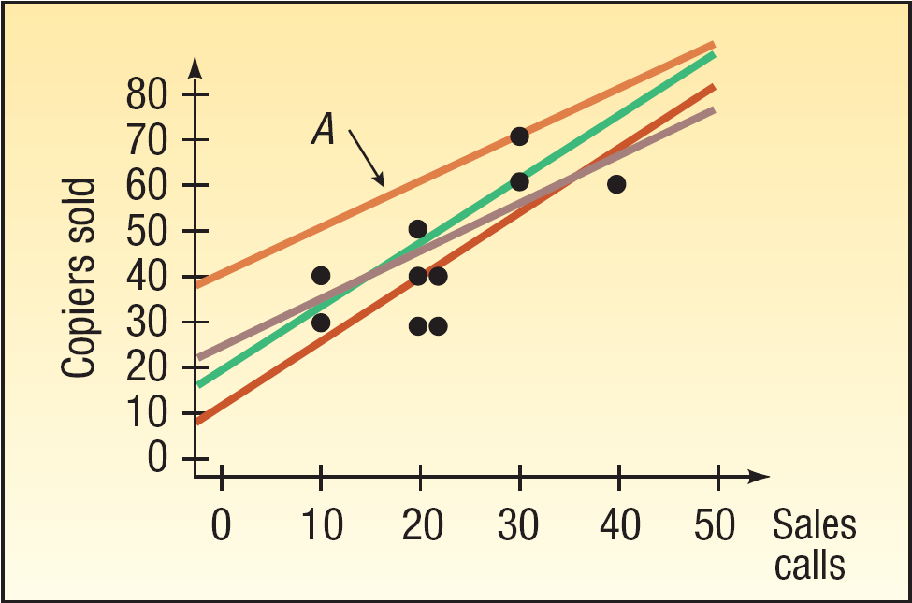
Regression Analysis – Least Squares Principle
The least squares principle is used to obtain a and b.

Slide 33
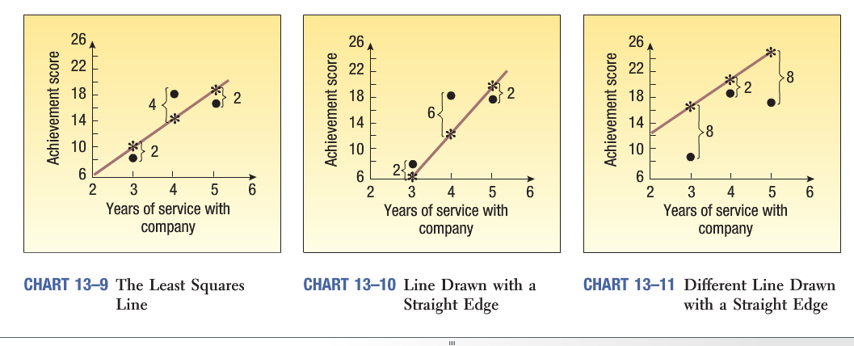

Slide 34
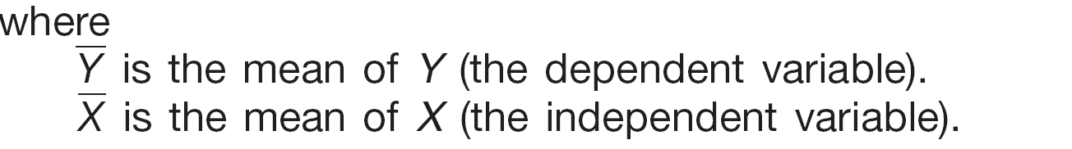
Computing the Slope of the Line and the Y-intercept
where:

Slide 35
Regression Equation – Example
Recall the example involving Copier Sales of America. The sales manager gathered information on the number of sales calls made and the number of copiers sold for a random sample of 10 sales representatives. Use the least squares method to determine a linear equation to express the relationship between the two variables.
What is the expected number of copiers sold by a representative who made 20 calls?

Slide 36
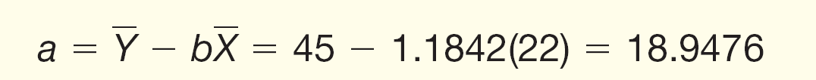
Finding and Fitting the Regression Equation – Example
Step 1: Find the slope (b) of the line
Step 2: Find the Y-intercept (a)
13-36

Slide 37
The Standard Error of Estimate
The standard error of estimate measures the scatter, or dispersion, of the observed values around the line of regression.
Formulas used to compute the standard error:

Slide 38
Standard Error of the Estimate – Example
Recall the example involving Copier Sales of America. The sales manager determined the least squares regression equation as given below.
Determine the standard error of estimate as a measure of how well the values fit the regression line.

Slide 39
Computing the Estimates of Y
Step 1: Using the regression equation, substitute the value of each X to solve for the estimated sales

Slide 40
Y-intercept
The y-intercept is the point where the line crosses the y-axis; in other words, it’s the value of y when x equals zero.
The y-intercept of a regression line may or may not have a practical meaning depending on the situation.
To determine whether the y-intercept of a regression line has practical meaning, look at the following:
Does the y-intercept fall within the actual values in the data set? If yes, it has practical meaning.
Does the y-intercept fall into negative territory where negative y-values aren’t possible?
Does the value x = 0 have practical meaning? For example, if x is temperature then x = 0 may be a value that’s relevant to examine. If x = 0 has practical meaning, then the y-intercept does too, because it represents the value of y when x = 0. If the value of x = 0 doesn’t have practical meaning in its own right then the y-intercept doesn’t either.

Slide 41
Coefficient of Determination
The coefficient of determination (r²) is the proportion of the total variation in the dependent variable (Y) that is explained or accounted for by the variation in the independent variable (X). It is the square of the coefficient of correlation.
Value ranges from 0 to 1, or 0 to 100%.
Does not give indication on the direction of the relationship between the variables.

Slide 42
Coefficient of Determination (r²) – Copier Sales Example
The coefficient of determination, r², is 0.576 (or 57.6%).
Found by (0.759)².
Interpretation:
57.6 percent of the variation in the number of copiers sold is explained, by the variation in the number of sales calls.

Slide 43
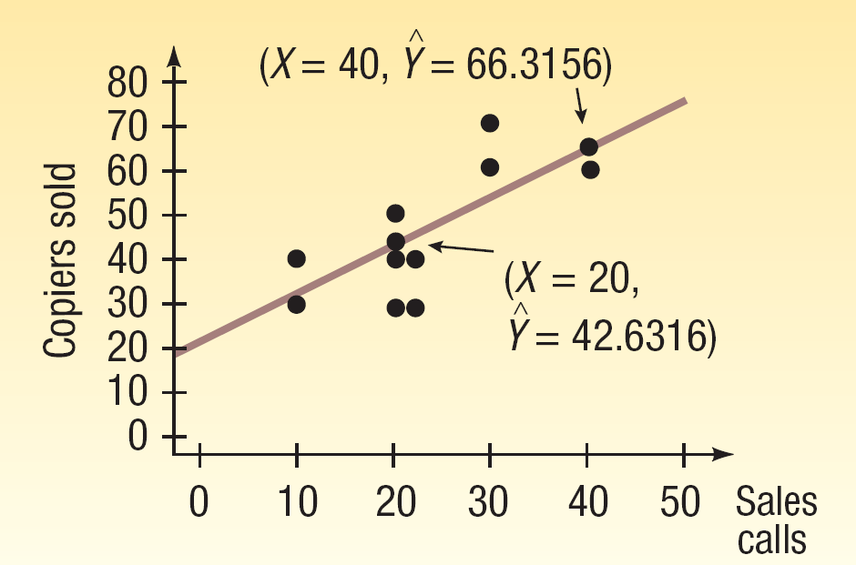
Plotting the Estimated and the Actual Y’s

Slide 44



Simple Linear Regression Model
Linear Model:
Each observation can be written as:
Least Squares Regression Line
The estimates are called the least squares estimates of β0 and β1 because they are the solution to the least squares method,
Fitted values for each observation

Slide 45
Different samples…
We need to step back and take into account the fact that sample results will vary.
We shouldn’t just say: “Okay, the slope of this line is x. Job done!”
It won’t be exactly the same next time. Samples will differ.
The data were used to figure out the best-fitting line, and you know it fits well for that data.
That’s not to say that the best-fitting line will work perfectly well for a new data set taken from the same population. So, in regression, all your results should involve the standard error with them in order to allow for the fact that sample results vary.
That goes for estimating and testing for the slope and y-intercept and for any predictions that you make

Slide 46
Model fit
In creating the regression line we have built a model.
So the most-important job remains to be completed:
checking to be sure that the conditions of the model are truly met
…and that the model fits well in more specific ways than the scatterplot and correlation measure.
Two major conditions must be met before you apply a simple linear regression model to a data set:
The y’s must have an approximately normal distribution for each value of x.
The y’s must have a constant amount of spread (standard deviation) for each value of x.

Slide 47
Residuals
A residual is the difference between the predicted value (from the best-fitting line) and the observed value of y, also known as y (from the data set).
Its notation is (y – ŷ). Specifically, for any data point, you take its observed y-value (from the data) and subtract its expected y-value (from the line).
If the residual is large, the line doesn’t fit well in that spot. If the residual is small, the line fits well in that spot.

Slide 48
Using Residuals to Test the Assumptions of the Regression Model
The following are the assumptions of the simple regression analysis:
the model is linear
the error terms have constant variances (homoscedasticity)
the error terms are independent
the error terms are normally distributed
Residual plot – a graph in which the residuals for a particular regression model are plotted along with their associated value of x

Slide 49
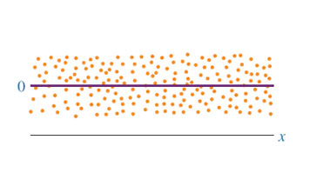
Healthy Residual Plot
Notes:
21

Slide 50
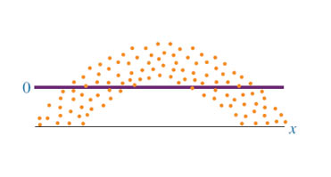
Nonlinear Residual Plot
Notes:
18

Slide 51
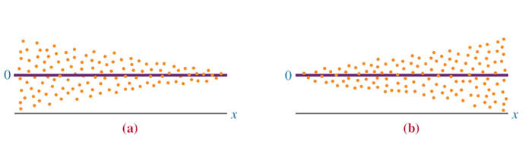
Nonconstant Error Variance
Notes:
19

Slide 52
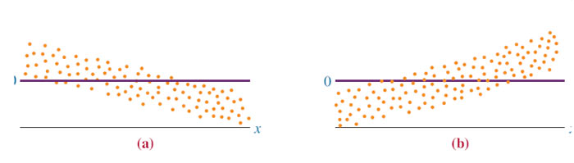
Graphs of Non-independent Error Terms
Notes:
20

Slide 53
Outliers
REGRESSION OUTLIERS
Influence outliers:
These are outliers that result from the y variable being very far from the average of all the other y variables observed.
Leverage outliers
These are outliers that result from the x variable being very far from the average of all the other x variables observed. Because this lone observation is to the far left or right of the others it exerts more influence on the tilt of the line than the other observations. This kind of outlier can be particularly problematic and is usually removed from regressed data sets.

Slide 54
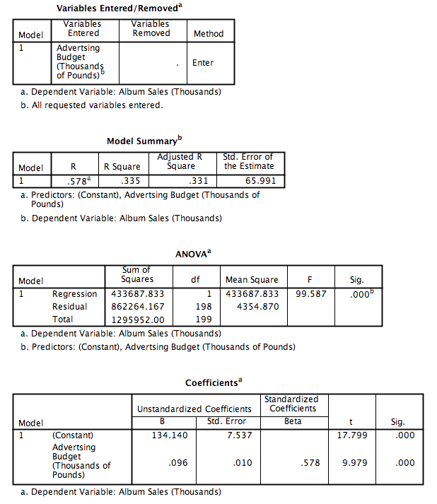
SPSS Linear Regression Example
Load AlbumSales.sav file given on Moodle

Slide 55
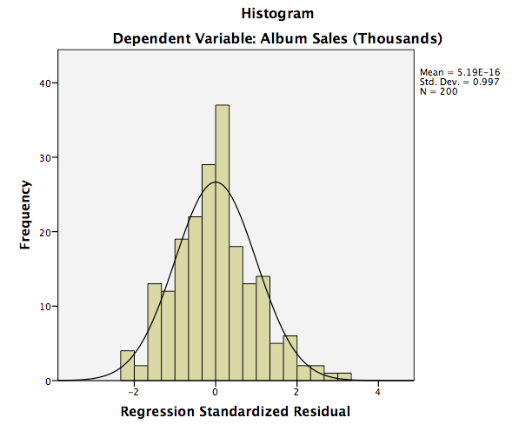
SPSS Linear Regression Example

Slide 56
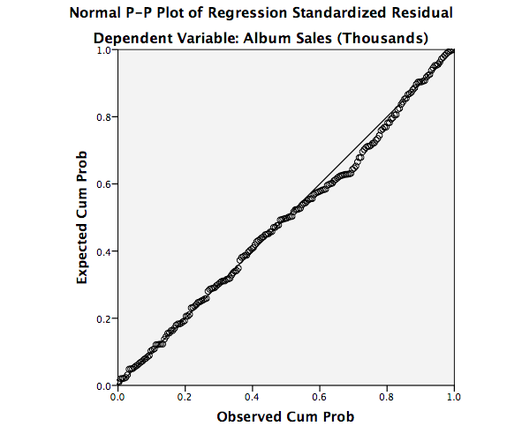
SPSS Linear Regression Example

Slide 57
Correlation & Simple Regression
Exploring relationships among variables

